Slide 1
Presentation: Particle System for the PSP
BSc Final REPORT Submitted for the BSc Honours in Computer Science with Games Development May 2009 Particle System for the PSP by Jamie Sandell

Slide 2
Presentation: Particle System for the PSP
Aims
Design and create a fully working particle engine and tool for the Sony PSP development kit
Discover not only just what a particle system is and how a particle system works, but, also, why such a system is required
How can the project be incorporated onto the Sony PSP, and, how can it run efficiently on the hardware that the Sony PSP

Slide 3
Presentation: Particle System for the PSP
What is a Particle System?
A particle system is a “method for modeling fuzzy objects such as fire, clouds, and water. Particle systems model an object as a cloud of primitive particles that define its volume.”

Slide 4
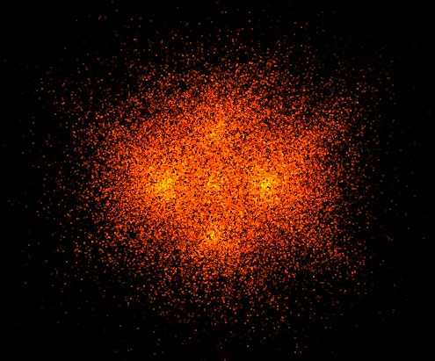
Presentation: Particle System for the PSP
What is a Particle System?
So particle systems can create such effects as shown below:

Slide 5
Presentation: Particle System for the PSP
What is a Particle System?
A Particle System is made up of individual particles, these particles are governed by a set of (individual properties):
Size
Colour
Speed
Life

Slide 6
Presentation: Particle System for the PSP
Algorithm for General Particle System
Particle is generated by an emitter
It’s new position is calculated
Yes
Yes
Render the particle
Life remaining?
No
Remove particle
Repeat?
No

Slide 7
Presentation: Particle System for the PSP
Why a Particle System?
One algorithm can generate many different effects (based on randomness and properties)
Particle Systems are chaotic, each particle can have a random element, called a stochastic component, which modifies its behaviour, this is why particle systems are so good at reproducing realistic effects.

Slide 8
Presentation: Particle System for the PSP
Efficiency Problems
Efficiency is an issue with particle systems, even on modern hardware
Hundreds of thousands of particles
New/Delete is too slow
Especially true of a handheld console
Incredibly smaller resources then a PC.

Slide 9
Presentation: Particle System for the PSP
Efficiency Solutions
New/Delete
Don’t delete particles, instead flag them as inactive so they don’t get drawn
Use arrays to store the particles
Arrays provide the most linear access to the available data
Accessing data linearly helps with caching
Reallocating arrays can be costly
To combat this allocate large block of memory.
Store pointer to the beginning
Store pointer at the end
Store pointer to next free space in array
Especially true of a handheld console
Incredibly smaller resources then a PC.

Slide 10
Presentation: Particle System for the PSP
Software Demo

Slide 11
Presentation: Particle System for the PSP
Software Performance
Limitations
Only draws geometric points – no lines nor triangles (both supported on the Sony PSP)
No textures
Doesn’t run properly using the official PSP SDK
Achievements
Developer can create/edit/save various particle effects on the PC

Slide 12
Presentation: Particle System for the PSP
Conclusion
Personal Gain
Exposure to console development
Understand the theory and practical (on the PC) sides of Particle Systems
Future Work and Improvements
Get it working on the Sony PSP
Support more geometric shapes such as lines and triangles
Textures
GUI overhaul written in .NET

